Slide 2
https://www.youtube.com/watch?v=9TC8c2se0xs&list=PLDuDKKBaUvlMptkmjl32wGLFzfgswaSM0&index=2
How to develop a love of reading
Click on the link below to learn how to support your child in developing a love of reading.

Slide 3
https://www.youtube.com/watch?v=oQN-blu9-Jw
The Importance of Reading

Slide 4
Through sharing books with you, your child will develop a love of reading and sharing stories which will progress onto them reading for themselves.

Slide 6
Please point out signs, labels and logos whilst you are out and about to show your child the importance of reading in daily life.

Slide 7
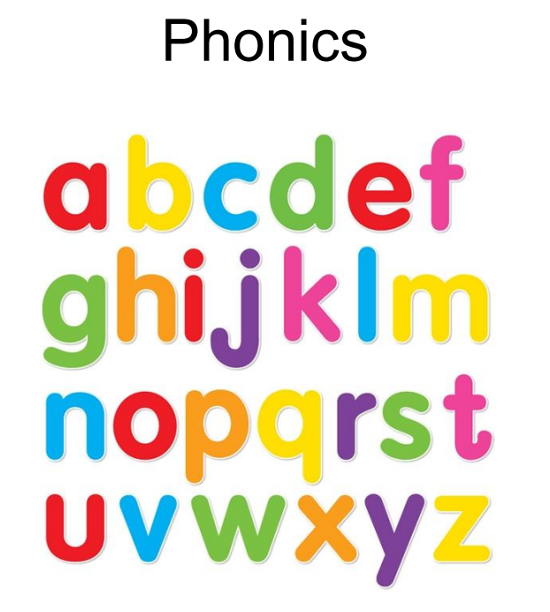
The children start by learning how to say a sound for all the individual letters of the alphabet. They then learn how to pronounce diagraphs ( 2 letters) and trigraphs (3 letters). This is where we use the Monster Phonics characters to support.
Introduction to the Monsters
https://monsterphonics.com/free-resources/free-videos/the-monster-song/
How the monsters work to support.
https://www.youtube.com/watch?v=AJsIpcXdI7Y
Free webinar for parents sign up page
https://ebooks.monsterphonics.com/parents-webinar/

Slide 8
Monster Phonics - the link video below shows you the actions and models how to pronounce the sounds. The children will bring home the sounds and key words every Friday. Please support your child to learn these. In Reception, the children learn sounds in Phases 2 and 3. Phase 4 consolidates these sounds in longer words.
https://www.youtube.com/watch?v=S8a4I5Uzrbk

Slide 9
Blending
Once your child knows some sounds and can blend 2 or 3 sounds together, they will be given a reading book (words). Books will be changed every Monday and Thursday unless we feel you child needs longer. The link below demonstrates blending sounds ( scroll down page).
https://home.oxfordowl.co.uk/reading/what-is-letters-and-sounds/

Slide 10
https://www.oxfordowl.co.uk
Oxford Owl
This website has lots of information on how to support your child in reading as well as e-books for your child to read during school holidays. It is free to join.

