Slide 1
Welcome to Reception Class

Slide 2
Aims of the PowerPoint.
To be introduced to the staff.
To have a basic understanding about the Reception Year and end of
year expectations.
To know what a typical day will look like.
To know how you can support your child.
To look at school uniform.

Slide 3
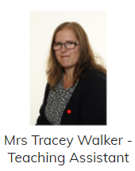
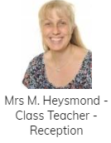
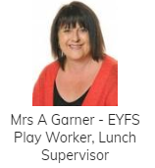
Meet the Staff
Mrs. Garner and myself are based in Reception Class and Miss Bingham and Mrs Payne are based in Nursery. works in both. As we work as a unit, children can free flow between the Nursery side, Reception side and outside during choosing time and all staff make observations on all children.
This year we will be working as an EYFS unit. Mrs Garner and myself will be based in Reception and Miss Bingham, Mrs Payne and Mrs Walker will be working within Nursery.

Slide 4
The Sculptors
I dreamt I stood in a studio
And watched two sculptors there
The clay they used was a young child’s mind
And they fashioned it with care
One was a teacher, the tools he used
Were books and music and art.
One was a parent with a guiding hand
And a gentle loving heart……………………
……..And each agreed they would have failed
If they had worked alone
For behind the parents stood the school
And behind the teacher, the home.
( Anon)
The Reception Year is all about building the foundations in your child’s education as they begin to read and write, and it is really important for your child to have your support at home to ensure they have the best chance to achieve their full potential.

Slide 5
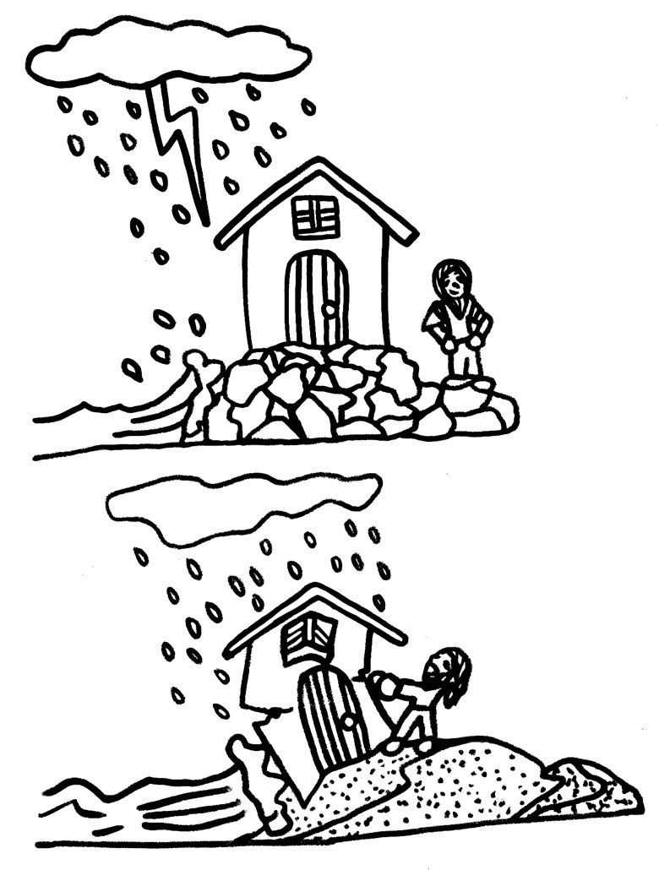
The Reception Year is all about building strong foundations for the rest of your child’s education.
At school, we plan activities and provide opportunities for children to build upon their current ability.
Your help at home is equally as important too.

Slide 6
EYFS curriculum
7 key areas
Personal, Social and Emotional Development
Communication and language
Physical Development
Literacy
Mathematics
Understanding the World
Expressive Arts & Designs
The Early Learning Goals have recently changed. On the next few slides are the expectations in each area that your child is expected to achieve by the end of the year.

Slide 7
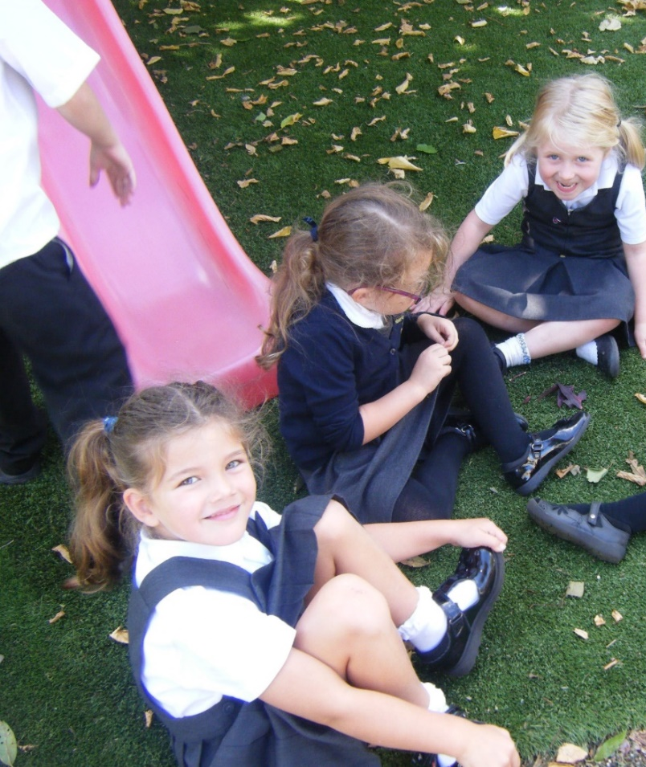
Personal, Social and Emotional Development
Self-Regulation
Show an understanding of their own feelings and those of others, and begin to
regulate their behaviour accordingly;
Set and work towards simple goals, being able to wait for what they want and control
their immediate impulses when appropriate.
Give focused attention to what the teacher says, responding appropriately even when
engaged in activity and show an ability to follow instructions involving several ideas or actions.
Managing Self
Be confident to try new activities and show independence, resilience and perseverance in the face of challenge.
Explain the reasons for rules, know right from wrong and try to behave accordingly.
Manage their own basic hygiene and personal needs, including dressing, going to the toilet and understanding the importance of healthy food choices.
Building Relationships
Work and play cooperatively and take turns with others.
Form positive attachments to adults and friendships with peers.
Show sensitivity to their own and to others’ needs.

Slide 8
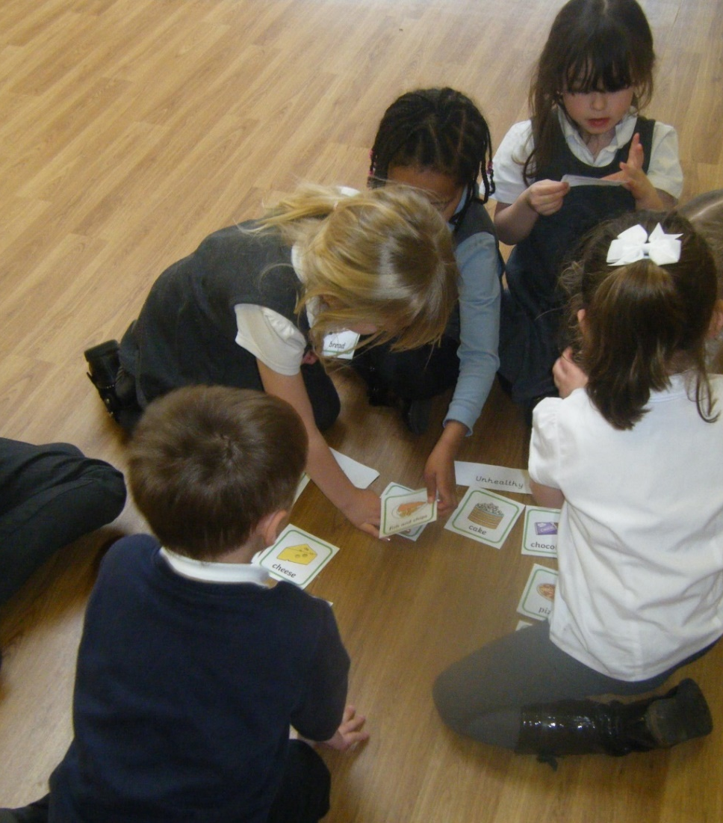
Communication and Language
Listening and attention
Listen attentively and respond to what they hear with relevant questions, comments and
actions when being read to and during whole class discussions and small group interactions.
Make comments about what they have heard and ask questions to clarify their
understanding.
Hold conversation when engaged in back-and-forth exchanges with their teacher and
peers.
Speaking.
Participate in small group, class and 1-to-1 discussions, offering their own ideas, using recently introduced vocabulary.
Offer explanations for why things might happen, making use of recently introduced vocabulary from
stories, non-fiction, rhymes and poems when appropriate.
Express their ideas and feelings about their experiences using full sentences, including use of past, present and future tenses and making use of conjunctions, with modelling and support from their teacher.
.

Slide 9
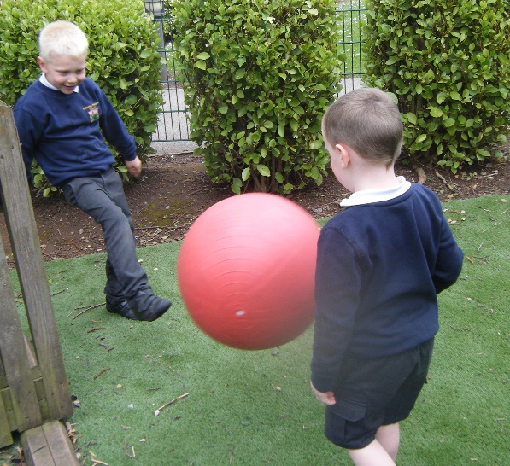
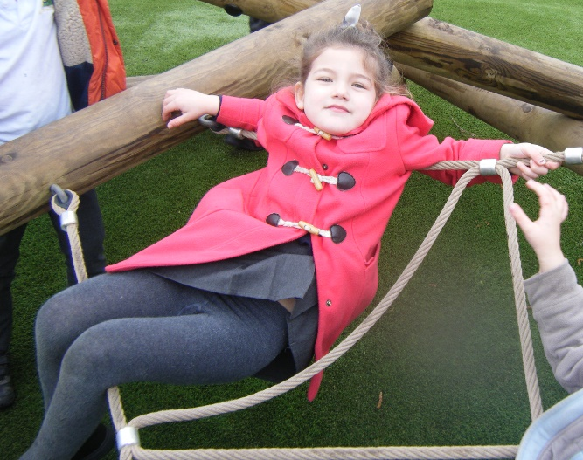
Physical Development
Gross Motor Skills
Negotiate space and obstacles safely, with consideration for themselves and others.
Demonstrate strength, balance and coordination when playing.
Move energetically, such as running, jumping, dancing, hopping, skipping and climbing.
Fine Motor
Hold a pencil effectively in preparation for fluent writing –
using the tripod grip in almost all cases.
Use a range of small tools, including scissors, paintbrushes and cutlery.
Begin to show accuracy and care when drawing.

Slide 10
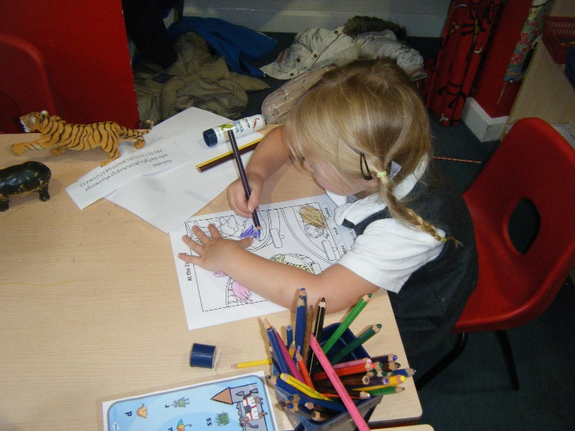
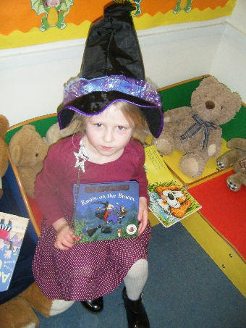
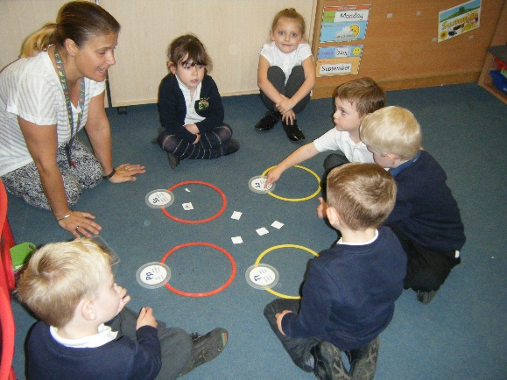
Literacy
Comprehension
Demonstrate understanding of what has been read to them by retelling stories and narratives using their own words and recently introduced vocabulary.
Anticipate (where appropriate) key events in stories.
Use and understand recently introduced vocabulary during discussions about stories, non-fiction, rhymes and poems and during role-play.
Word Reading
Say a sound for each letter in the alphabet and at least 10 digraphs.
Read words consistent with their phonic knowledge by sound-blending.
Read aloud simple sentences and books that are consistent with their phonic knowledge, including common exception words.
Writing
Write recognisable letters, most of which are correctly formed.
Spell words by identifying sounds in them and representing the sounds with a letter or letters.
Write simple phrases and sentences that can be read by others.

Slide 11
Reading
Oxford Reading Characters (ORT) characters names
ORT books – no writing, children to discuss pictures then make up a story. These progress into simple words/sentences.
Phonics books ( Monster Phonics/RigbyStars)
Choice reading books for an adult to read ( modelling reading/developing a bank of stories) – these can be changed daily.
Phonemes (sounds) sent home weekly
Tricky words to learn – sent home as necessary.
Joining the local library will be great if you’re not a member already.

Slide 12
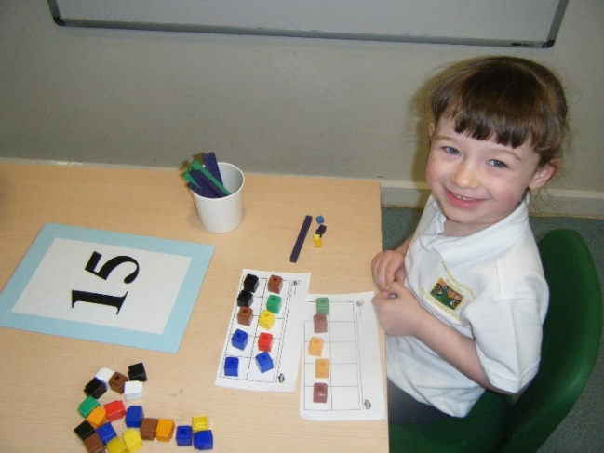
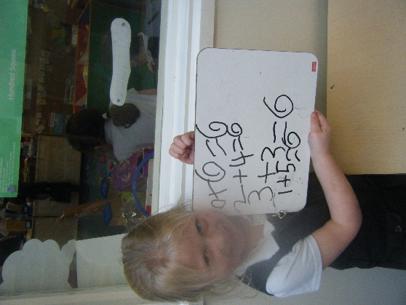
Mathematics
Number
Have an deep understanding of number to 10, including the composition of each number.
Subitise (recognise quantities without counting) up to 5.
Automatically recall ( without reference to rhymes, counting or other aids) number bonds up to 5 ( including subtraction facts) and some number bonds to 10, including double facts.
Numerical Patterns
Verbally count beyond 20 recognising the pattern of the counting system.
Compare quantities up to 10 in different contexts, recognising when one quantity is greater than, less than or the same as the other quantity.
Explore and represent patterns within numbers up to 10, including evens and odds, double facts and how quantities can be distributed equally.

Slide 13
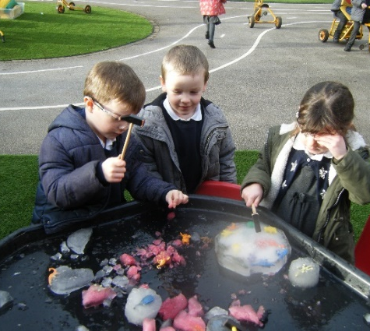
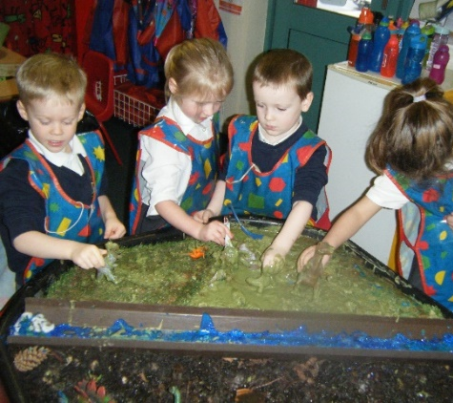
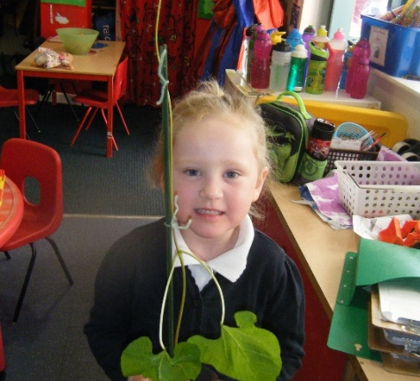
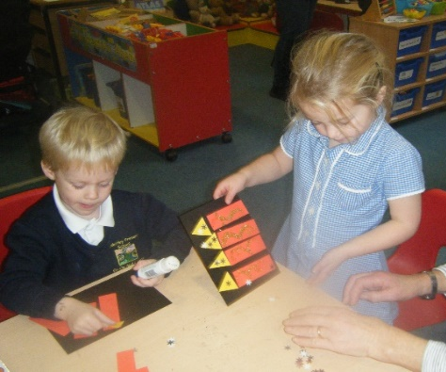
Understanding the world
Past and Present
Talk about the lives of the people around them and their roles in society.
Know some similarities and differences between things in the past and now, drawing on their experiences and
what has been read in class.
Understand the past through settings, characters and events encountered in books read in class and story telling.
People, Culture and Communities
Describe their immediate environment using knowledge from observation, discussion, stories, non-fiction texts and
maps.
Know some similarities and differences between different religious and cultural communities in this country,
drawing on their experiences and what has been read in class.
Explain some similarities and differences between life in this country and life in other countries, drawing on
knowledge from stories, non-fiction texts and (when appropriate) maps.
The Natural World
Explore the natural world around them, making observations and drawing pictures of animals and plants.
Know some similarities and differences between the natural world around them and contrasting environments,
drawing on their experiences and what has been read in class.
Understand some important processes and changes in the natural world around them including the seasons and changing states of matter.

Slide 14
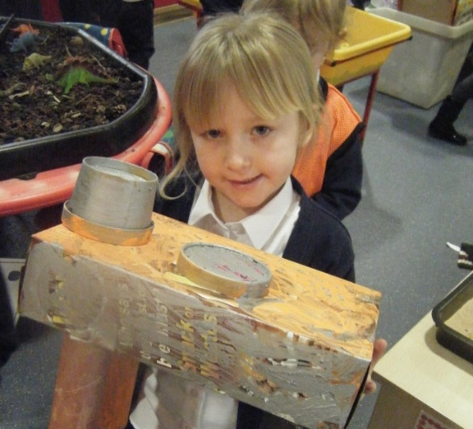
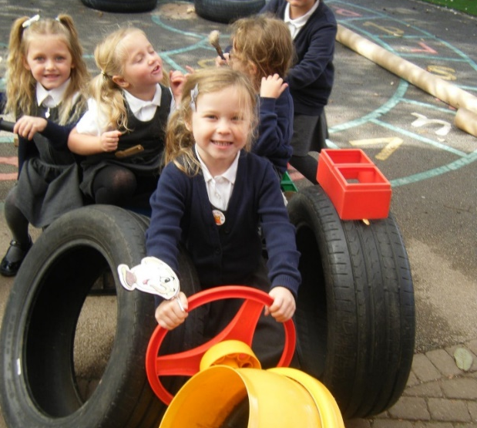
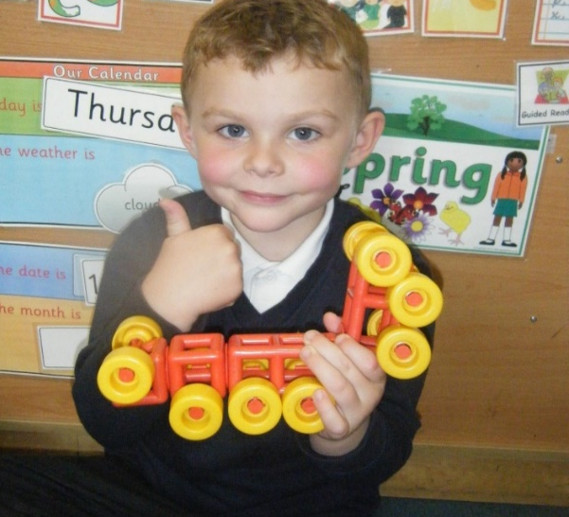
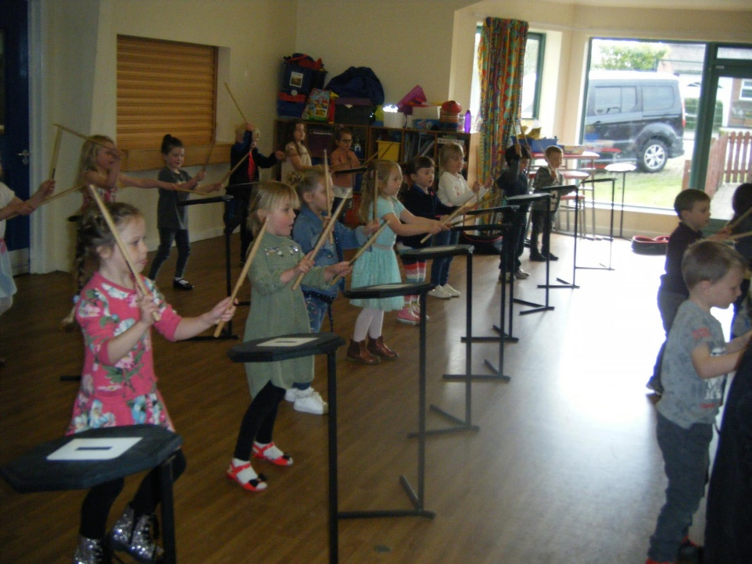
Expressive arts and design
Creating with Materials
Safely use and explore a variety of materials, tools and techniques, experimenting with colour, design, texture, form and function.
Share their creations, explaining the processes they have used.
Make use of props and materials when role-playing characters in narratives and stories.
Performing
Invent, adapt and recount narratives and stories with peers and their teacher.
Sing a range of well-known nursery rhymes and songs.
Perform songs, rhymes, poems and stories with others, and (when appropriate) try to move in time with music.

Slide 15
Assessment
Assessments from previous nursery/childcare provision.
Sept – baseline assessment
Ongoing observations/evidence in books//Parent’s contributions to ‘Evidence Me’. You will be sent a link to access this if you are not already in our Nursery.
Each Term – see if children are on track.
End of year ( June) – whether has achieved the Early learning Goals (ELG).

Slide 16
“Is my little one ready for school ?”
When starting big school children need to be able to:
Express their needs appropriately
Use the toilet independently
Wash and dry hands
Blow their nose
Sit at a table and use a knife and fork
Eat their lunch properly
Dress and undress themselves
Sit quietly to listen to a story or a piece of music
Wait patiently
Share and take turns
Tidy up things they have used
Say goodbye with a smile !!!!!!!!
Please work on any of these skills over the next few weeks if necessary to give your child the best start in September.

Slide 17
Ready to Learn
Ensure your child has good nights sleep.
Arrives at school on time – between 8.30 - 8.40am.
Their book bag supplied from school with reading diary, reading book, choice book.
Water bottle – water not juice.
Coat, hat, gloves, sun hat.
Please check your child’s book bag daily for any letters although most correspondence is sent via Dojo.
Please don’t bring toys to prevent being broken, competition or peer pressure.

Slide 18
Learning through Play
Play is an important part of the daily routine in the foundation stage.
Play in the foundation stage is well planned by the EYFS team and is aimed at developing the children’s ability to explore creatively.
The play that the children engage in helps to enhance the children’s learning as they are continually learning through a wide variety of activities.

Slide 19
A Typical Day – morning
8.30 – Classroom door opens for children to come in. Reading.
8.45 - Register
8.50 – Visual Timetable
9.00 – Phonics – we use the Monster Phonics Scheme
9.20 – Child initiated indoor/ outdoor play
10.25- Assembly
10.40 – Break on big playground
11.00 – Maths
11.30 – Dinner.

Slide 20
Afternoon
12.30 – Literacy - Talk for Writing
12.50 - Child initiated activities
2.15 – Tidy up time
2.25 – Water break
2.30 – Topic work/R.E/P.S.H.E
2.55 – Story time
3.15 – Home time

Slide 21
Keep in touch
Class Dojo
Visit our website to see what we have been up to – www.kimberleyprimary.org.uk
Send in observations to share achievements at home via ‘Evidence Me’.
Attend open mornings.
Attend parents’ evenings.

Slide 22
Getting in Touch with the school
Ring the school
or
drop in a note
if….
…. your child is going to be late.
… your child is ill.
… your contact details have changed.
… your child is going on holiday during term time.
… you are going to be late picking up your child.
… your home or family circumstances change.

Slide 23
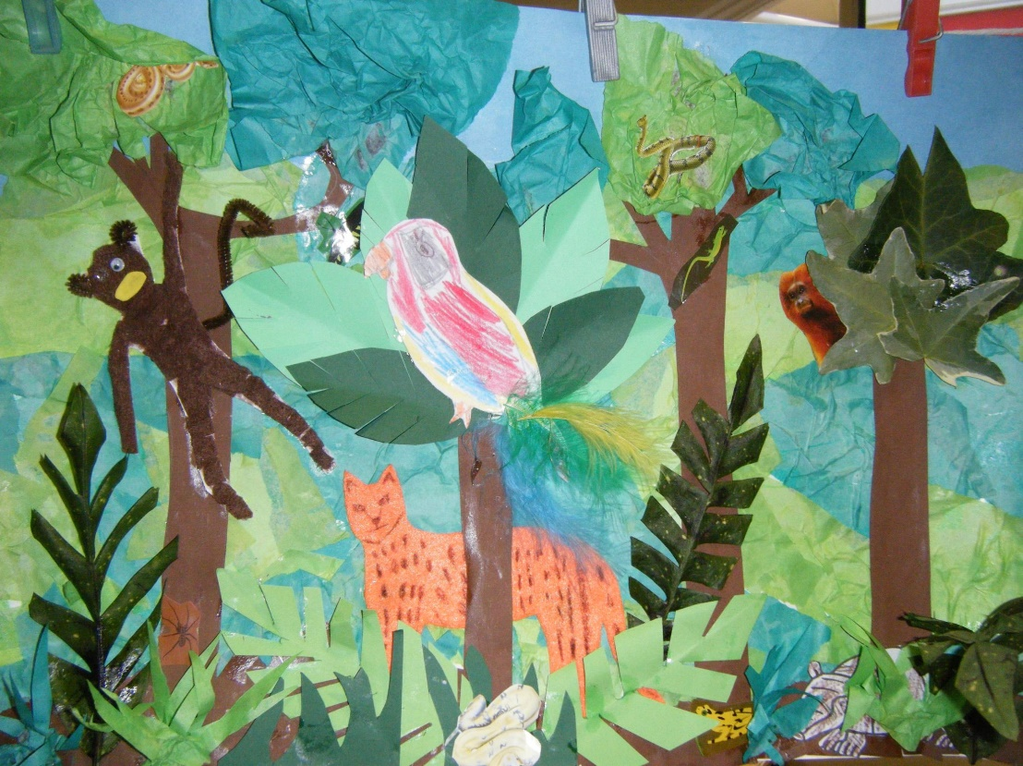
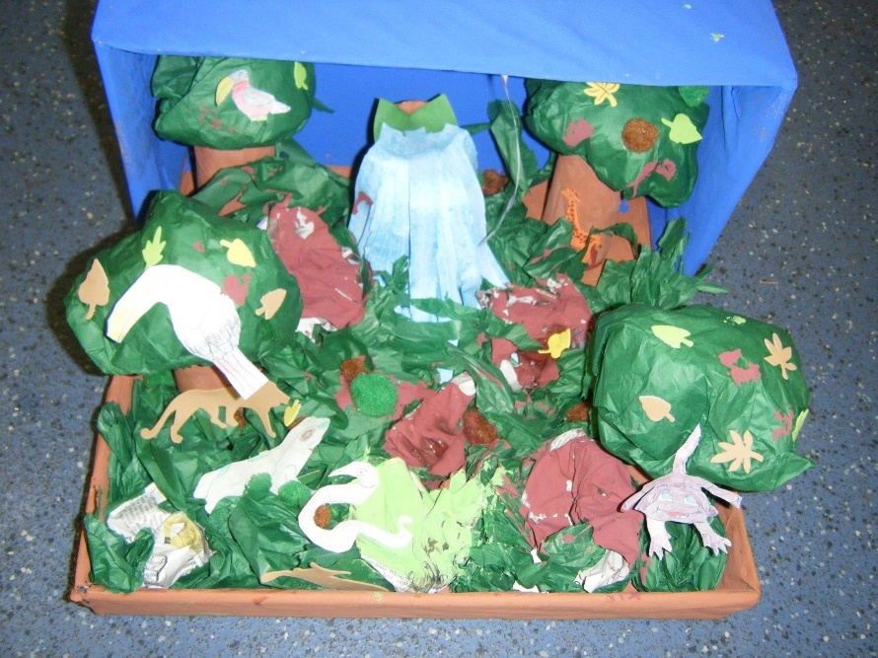
Homework
Read at least 4 times a week and sign reading diary.
Practise weekly phonic sounds and key words.
Family homework projects.
Other, sent by Class Dojo.
Your support really matters.

Slide 24
Uniform
Boys – navy or white polo shirt/, dark grey trousers, navy blue jumper, grey or
black sock, black shoes, grey shorts.
Girls – dark grey skirt/trousers, white blouse/white or blue polo shirt, navy blue
cardigan/jumper, white/grey/black socks, black shoes, blue check dress.
Please label all clothes so that they can be returned if mislaid.

Slide 25
P.E
P.E Kit – A P.E bag will be provided for your child.
- light blue t.shirt, blue shorts, trainers, tracksuit.
- long hair needs to tied back and all jewellery removed.
Please label all P.E kit so that it can be easily be returned.
P.E kit to stay in school for ½ term.

Slide 26
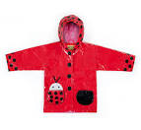
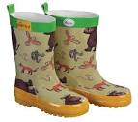
Come rain or shine
​ The Early Years Foundation Stage is all about learning through play and a big part of this play happens outdoors. We will take our learning outside whatever the weather, so please make sure your child comes to school with the right kinds of clothes for the right kind of weather to enjoy this aspect of their learning and development.​

Slide 27
Muddy Monday’s
On Monday’s all children take part in activities out on the big playground.
We have small groups over the day that go out with Mrs Payne to take part in some outdoor learning.
Your child will need:
Wellies.

Slide 28
Fantasy Friday’s
On Friday’s all children can to school dressed as a favourite character. To support to help them with storytelling.

Slide 29
Voluntary Contributions
Each week, we use a variety of consumables e.g. ingredients for play dough, pasta, shaving foam.
We also bake throughout the year and taste food linked to our topics.
In order to support these activities we ask for £1 contribution each ½ term ( £6 year)

Slide 30
Learning Journey Folders
Please can you provide your child with a double leaver arch folder, unless they are currently in our Nursery. This can be personalised to them with stickers if you wish.
We use these folders to keep all of their observations during their time in Reception.

Slide 31
Other
Medical needs:
Inhalers
We need an inhaler ( and spacer if required) to stop in school. This will need to have your child’ name on.
Head lice
Please check your child’s hair on a daily basis and treat if your child has live head lice or eggs.

Slide 32
Any Questions?

