Slide 1
Welcome to KPS Nursery

Slide 2



What is the Early Years Foundation Stage?
Early Years Foundation Stage consists of two classes.
Nursery - children aged 3-4 years [F1, Nursery, Penguin class]
Children can start Nursery the term after they turn 3 years old.
Reception – children aged 4-5 years [F2, Reception, Tiger class]
Children that are becoming 5 years of age during the academic year.

Slide 3
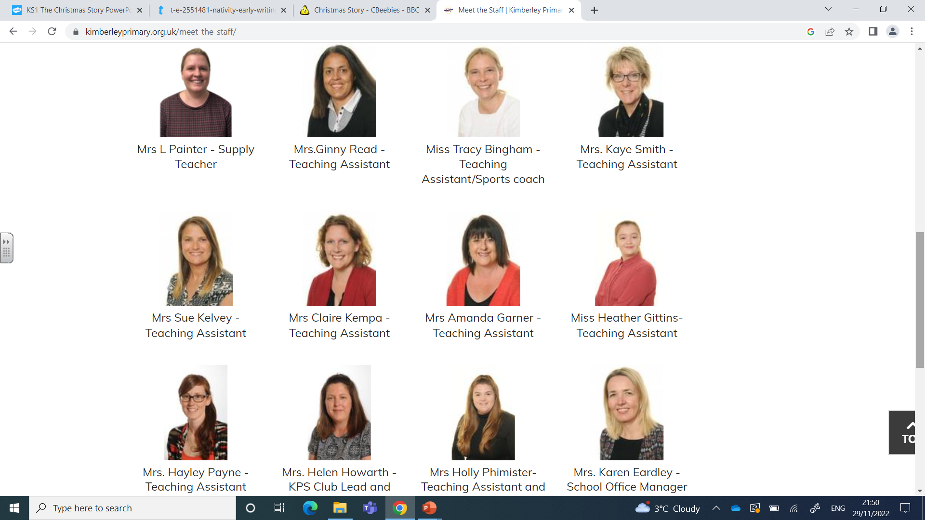
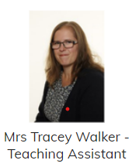
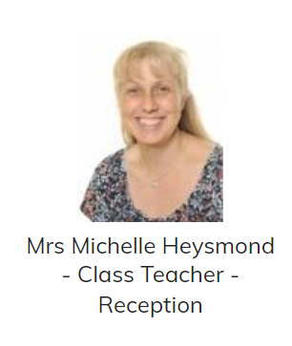
Meet the staff

Slide 4
The Nursery Day
Morning Sessions
Afternoon Sessions
Morning sessions begin
8:30-8:45
Drop off at the Nursery outdoor area, through the Pupil Entrance.
Morning sessions finish at 11:30
Pick up at the green gate near the Main School Entrance.
Afternoon sessions begin at
12:30
Drop off at the green gate near the Main School Entrance.
Afternoon sessions finish at 3:15-3:30
Pick up from the Nursery outdoor area, through the Pupil Entrance.

Slide 5

15 Hours and Top up sessions
We offer 15 hours provision which means you can use your free 15 hours for a morning or afternoon place 5 days a week. If you would like your child to attend additional hours you can put them down for top up sessions.
With this option you will be charged £10 pound for a session and £3 a day lunch time cover. It is an additional £2.75 if you want your child to have a school dinner.( Alternatively you can provide them with a packed lunch)
* 15 hours free can only be claimed at one setting . Eg. you can’t have free 15 hours at two different nurseries. You will be charged for all hours after the first 15 unless you have 30hr funding.

Slide 6
30 Hours
We offer 30 hours provision at our Nursery. These are on a first come first serve basis and can only be offered if you have a valid 30 hour code and depending on available space.
Although the sessions will be free you will be charged for lunch time cover at £3 a day plus £2.75 for a school dinner. (Children can bring a pack lunch if you prefer)
If your child goes to another setting as well as our Nursery you need to let the school office know. 30 hours can be shared between two settings.
To find out if you are eligible for 30 Hours funding please go on the government website. https://www.gov.uk/30-hours-free-childcare
30 Hour codes need to be updated every 3 months. If you don’t renew your code your child will only be able to attend for their free 15 hours.

Slide 7
Changing hours
We do not change Nursery hours during a term.
If you accept your child’s place you are agreeing to the hours you have chosen.
If your circumstances change and you would like to reduce or increase your child’s hours you can do this by the end of each term ready for the new term. All changes are subject to availability and up to date payments.
Autumn Term: September- December
Deadline: July for September
Spring Term: January- March
Deadline: By December for January changes
Summer Term: April- July
Deadline: By March for April Changes

Slide 8
How do I pay?
If your child is attending additional sessions you will be sent an invoice each month that you will have to pay online on your parent pay account.
Your child’s reference number and login details will be sent out the first week of school.
The first payment will be given/sent to you before their start date and this will need to be paid before your child starts Nursery.
This first payment will need to be paid by cheque as unfortunately your child’s parent pay account can’t be activated until they have begun Nursery.

Slide 9

KPS Club
We are very lucky that our school has a breakfast and after school club. This is open to all children.
Options
Breakfast club 7:15-8:45
without breakfast- £4.50
with breakfast - £5.50
Afterschool club 3:15-6:00 (Early bird until 4pm)
With a light tea £8.50
Early bird £3.50
You can pay through child care vouchers, or online. If you are interested please go to our school website where you can find the request form. Children have to be toilet trained to access this.

Slide 10

What should my child wear to Nursery?
At Kimberley Primary and Nursery School we would ideally like all our children in Nursery to wear school uniform (Navy Blue and black/grey). Uniform can be plain or with the school logo on.
Uniform with the school logo is available to purchase through Motif school uniform service.
http://motifs.co.uk/
We will be providing every child with a free Book Bag.

Slide 11

Come rain or shine......​
and everything in between...​
​
The Early Years Foundation Stage is all about learning through play and a big part of this play happens outdoors. We will take our learning outside whatever the weather [very little stops us!], so please make sure your child comes to Nursery with the right kinds of clothes for the right kind of weather to enjoy this aspect of their learning and development.​

Slide 12

Welly WeDNESDAY
On Wednesday’s all children take part in Welly Wednesday activities in the woodland behind the MUGA.
Over the course of the session we take part in Outdoor learning activities such as den building, planting, bug hunting and so much more!
Your child will need:
Wellies, a waterproof coat, gloves, hat, scarf.
Children can come to school in old clothes if you like as activities can get messy!

Slide 13
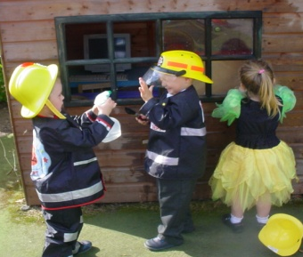
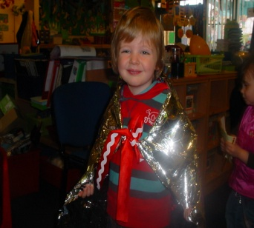
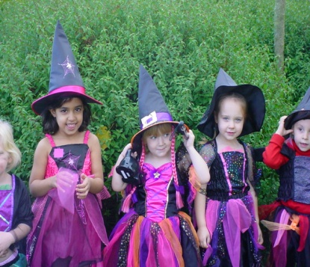
Fantasy Friday!
On Fridays we invite all of our Nursery children to dress up for the day for ‘Fantasy Friday’. This links closely with the EYFS area of learning known as ‘Expressive Arts and Design’. This is not a non-uniform day, but an opportunity for your child to explore and use their imagination by dressing as a favourite book or film character, for example. We don’t want you going out spending lots on dressing up clothes, a magic wand or a simple mask is enough to get your child to be creative! Your child does not have to dress up in this way on a Friday, as some children prefer to remain in their uniform at school, and this is absolutely fine. ☺

Slide 14

Snack Time
Drinks
Water - We actively encourage children to drink water throughout the session to keep them hydrated. Please bring a named water bottle for your child each day.
Milk - Please refer to the leaflet Cool Milk for more information about ordering milk for your child. If your child drinks a milk substitute eg oat milk then you can bring this with them at the beginning of the week and we can store it in the fridge for them
Fruit
As part of the government scheme to encourage healthy eating, fresh fruit is available for your child to eat everyday during snack
time. If your child attends all day you can send them with a healthy afternoon snack eg. fruit, cheese, vegetable or yoghurt.

Slide 15
What will a typical day in Nursery look like?
Here are some of the activities your child will be involved in each day…
Welcome to Nursery , songs, dances and Calender
Carpet Time - Phonics, Talk for Writing, Number time, Topic time, Story time, Squiggle Wiggle.
Free choice play and guided activities during play
Snack time
Small group guided activities or 1 to 1.
It’s a non-stop, fun packed session! ☺

Slide 16

Choosing their own learning:
During self-chosen learning times, children will have the opportunity to choose activities such as the ones listed below…
Sand and water play
Writing table
Maths area
Play dough/finger gym activities
Reading Area
Construction
Computer
Role play
Art and craft; model making
Outdoor play
Small world

Slide 17
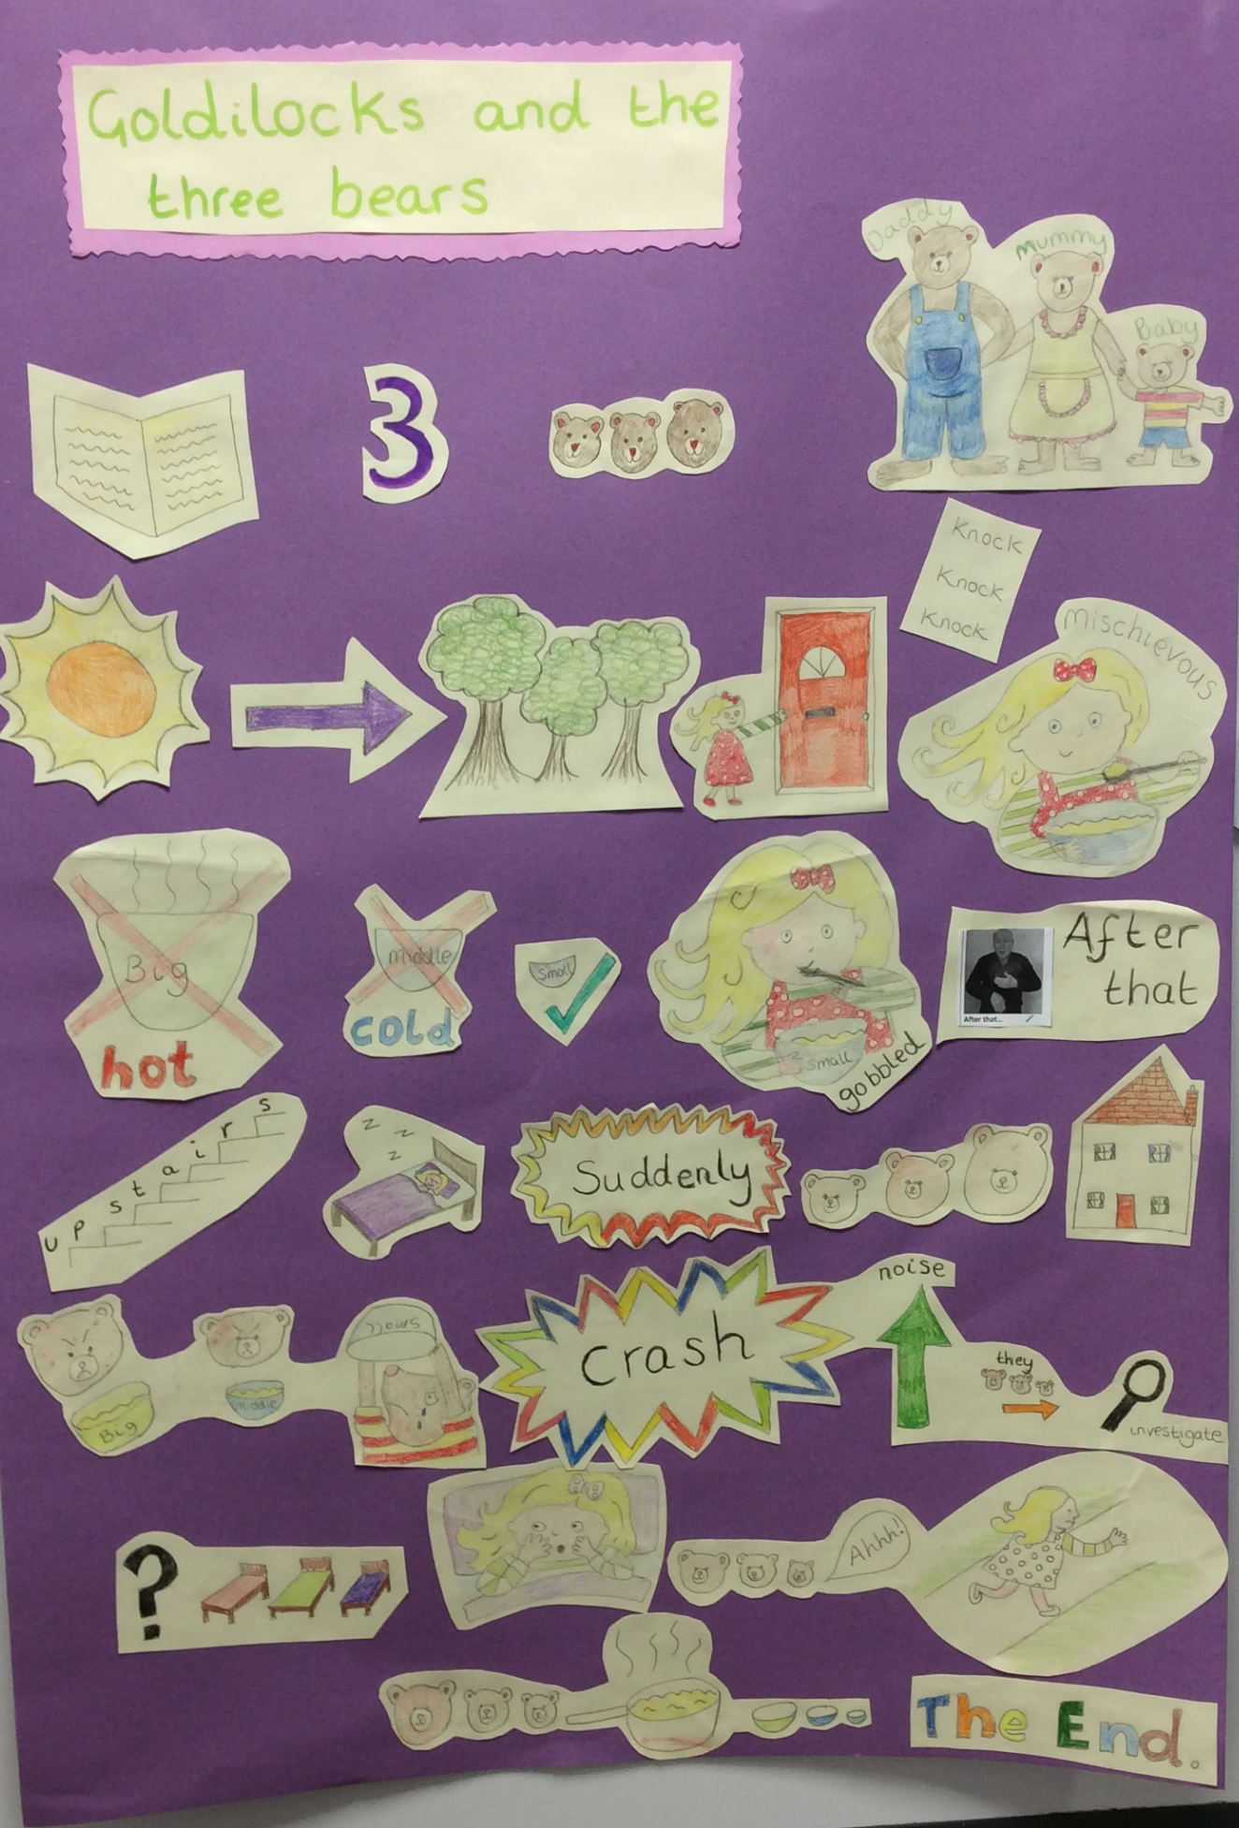
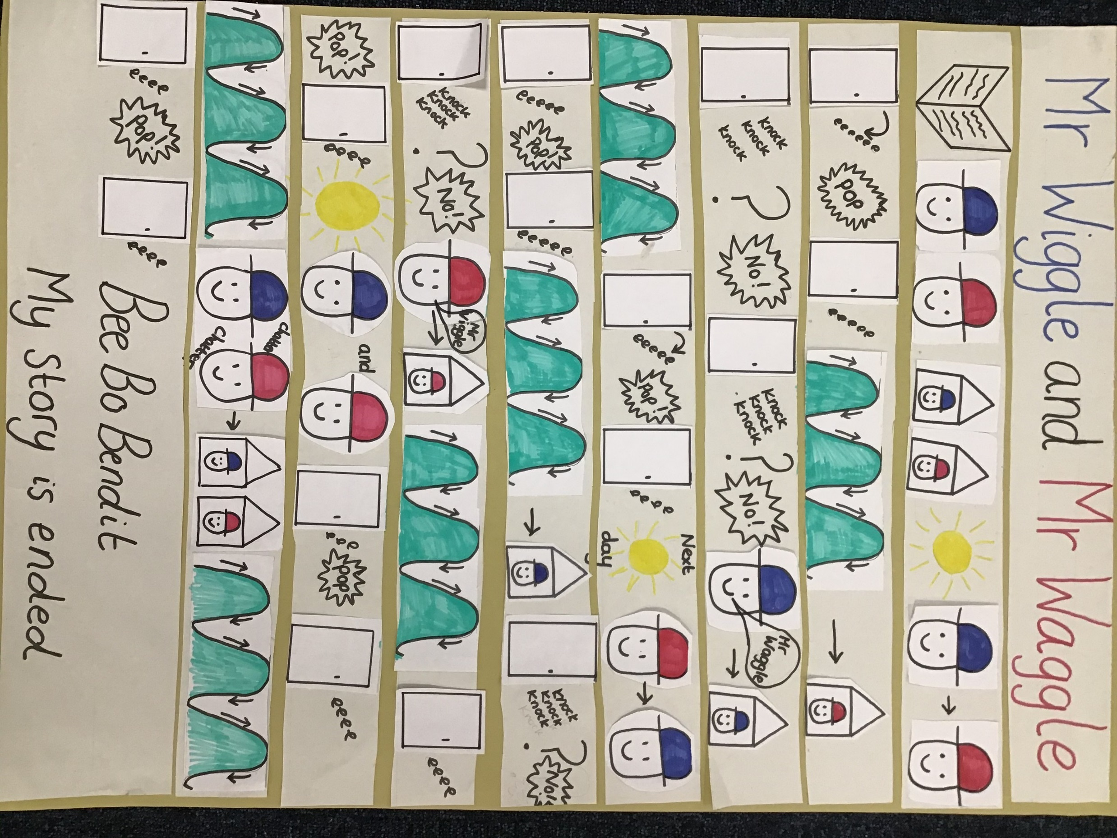
Talk For Writing
As a whole school we follow the Talk 4 Writing scheme.
During each half term we learn a book off by heart using a story map and actions.
When we have completed the story map this gets sent home to help children learn the story.
Talk 4 Writing helps to build confident story tellers and communicators.

Slide 18

Book bags
Your child is encouraged to choose a library book each day to bring home and share with you. Please ensure your child’s bag is clearly labelled with their name and check your child’s book bag regularly for the following items…
Paintings/pictures
Letters/important information
Party invitations.
Please don’t send in toys as these can get lost.

Slide 19


Learning Journeys and
WOW Moments!
During their time in the Early Years Foundation Stage, your child will have a learning journey Folder.
The learning journey will contain observations of your child and the work they have completed in Nursery. This learning journey then goes with your child into the Reception class, so that by the end of your child’s time in the EYFS, their learning journey will celebrate all that they have achieved over the two years.
We record observations on Evidence Me. When your child starts you will receive an Evidence Me sign up invite. By accepting this invite we can share observations of your child with you, and you can upload and share any achievements they have at home as well.

Slide 20

Class Dojo
Class Dojo is an app we use as a school. When your child starts you will receive your sign-up information .
On this app you will receive messages about events, important information or a means of contact. This messaging service works both ways and you can message me within work hours with any questions or queries .
There is a class page where we will share photos and weekly updates about what we have been learning each week.
You are also able to send me pictures of activities your child may have taken part in at home or new milestones/achievements.

Slide 21

Donations
To enable us to offer our children a variety of tactile experiences, as well as some baking opportunities, we are asking parents to donate £1 per half term if possible. This donation can be brought in in an envelope when your child starts.

Slide 22
What will help to ensure a smooth start for your child?
Can they go to the toilet on their own?
Ideally children should be in pants by the time they start Nursery and only in Nappies if they have a medical need.
Are they happy to be left with other people?
Can they put on their own coat/shoes?
Are they happy to tell someone if they are worried or something is upsetting them?
Do they still use a dummy?
We recommend that children try and give their dummies up when starting Nursery if they haven’t done so already. Using dummies can have a huge impact on a child’s speech and language development. If you need support with this, please speak to a member of staff and we will be happy to support you and your child.

Slide 23
What should I do If someone new is picking my child up from Nursery?
To keep our children safe, we will never let them go home with someone we haven’t seen before.
If someone new is picking your child up, please let a member of staff know.
You will need to let staff know a password ( any word or phrase) that we can ask the new person when they come to collect. Please make sure you share the password with the person collecting too.

Slide 24
THANK YOU
The first day of the Term will be Tuesday 3rd September
We can’t wait to see you!
If you have anymore questions please contact us via the school office and we will get back to you as soon as possible.
School number: 0115 938 5050
School email: office@kimberleyprimary.org
www.kimberleyprimary.org.uk

